Slide 1
MACHINE LEARNING BASED SMART GLASSES FOR VISUALLY IMPAIRED PEOPLE
VIJAYBHASKAR REDDY AGAVINTI
CHANDU CHANDRA

Slide 2
ABSTRACT
In the world of colors, It’s sad that some people can’t see because of some kind of visual impairment. So, we decided to build novel smart glasses based on a machine learning model.
These glasses can be capable of recognizing the images and produce output in audio format, so that the person with the visual impairment is able to hear and visualize what is in front of them.

Slide 3
INTRODUCTION
Machine learning based smart glasses for visually impaired people, Main goal is to detect an object, recognize it and produce the output in audio format.
This model uses a pretrained model by google net which has an accuracy of 95 percent.

Slide 4
TOOLS USED
Hardware:
i) Jetson nano 2GB
ii) Microsoft web camera
iii) Speakers
iv) Display
v) keyboard and mouse
vi) power adapter
Software:
i)GoogleNet
ii)UBUNTU
iii)gTTS

Slide 5
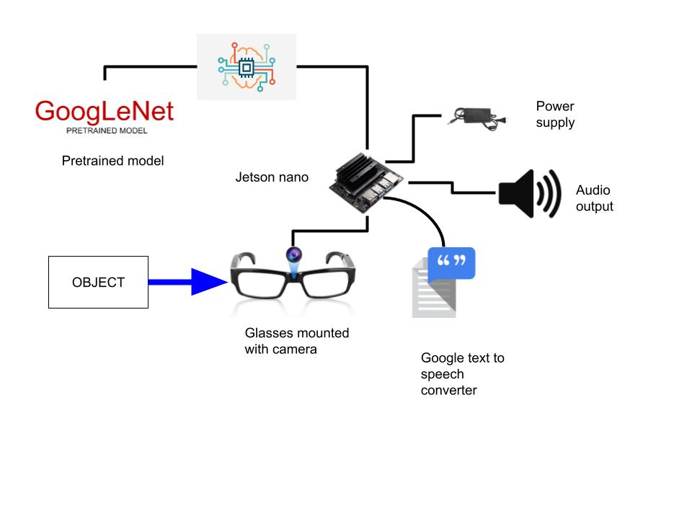
DESIGN

Slide 6
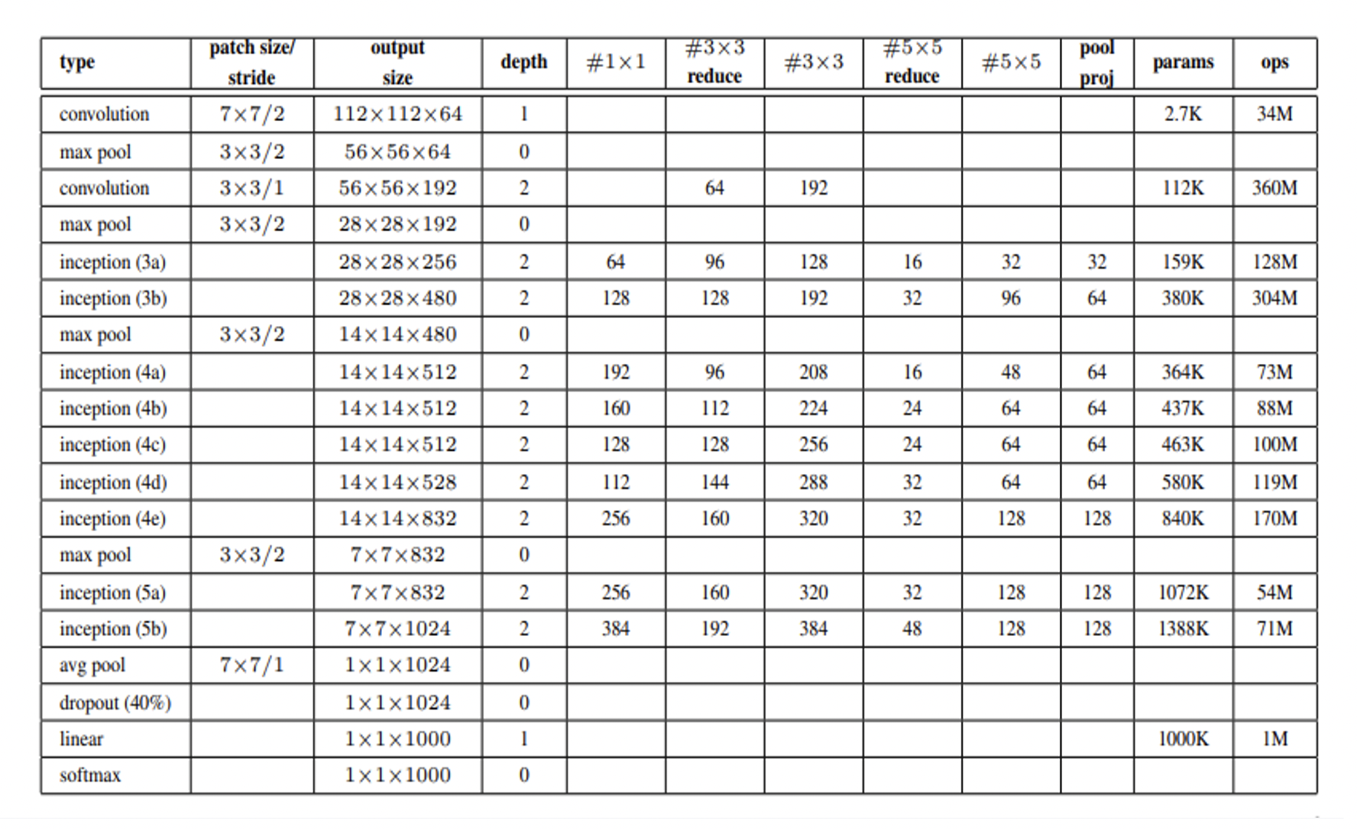
MODEL SUMMARY

Slide 7
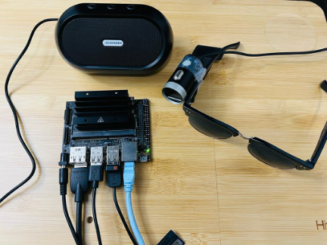

Slide 8
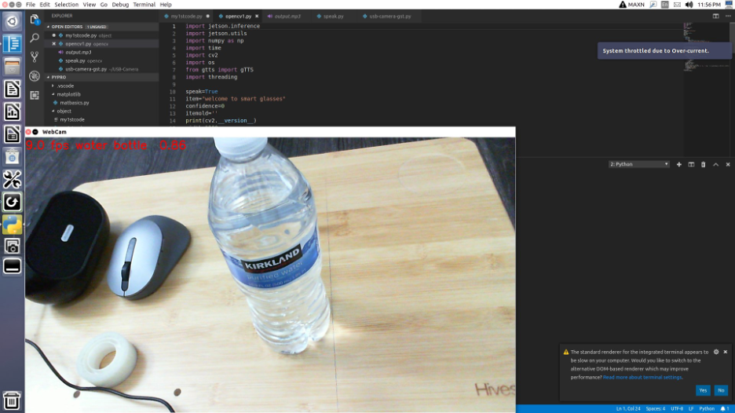
OUTPUT

Slide 9
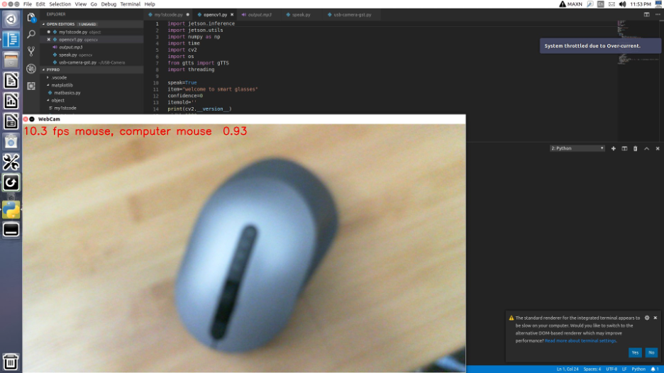
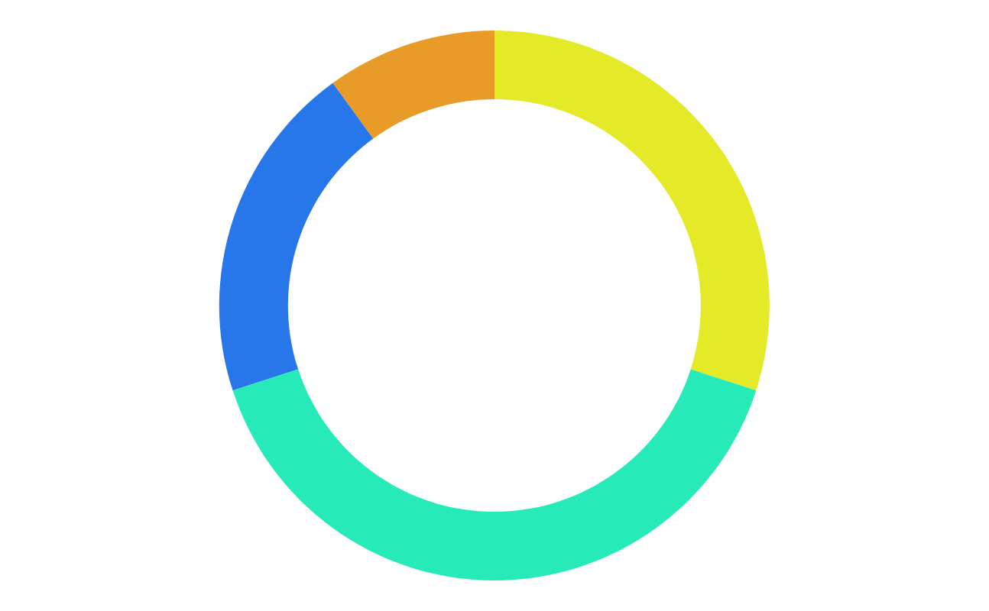
OUTPUT

Slide 10

SAMPLE AUDIO OUTPUT

Slide 11
Future work
We planned to include the text recognition feature to the smart glasses which can be used to read the test from the image captured by the camera.
We are also planning to implement the new feature in the future which allows glasses to remember faces and objects from which are not in the dataset, i.e.If smart glasses encounter a new object then the user will be able to add the name of the object to the memory of smart glasses. So that glasses are able to detect an object if we ask it again.

Slide 12
CONCLUSION
Since these smart glasses use a pre-trained model, it has a high accuracy of 95%, Which surpasses the previous model with an accuracy of 93%. This model will be further developed as we mentioned in the future work.

Slide 13
REFERENCES
https://www.geeksforgeeks.org/understanding-googlenet-model-cnn-architecture/
https://www.geeksforgeeks.org/convert-text-speech-python/
https://developer.nvidia.com/embedded/jetson-nano-developer-kit#:~:text=NVIDIA%C2%AE%20Jetson%20Nano%E2%84%A2,as%20little%20as%205%20watts.

Slide 14
THANK YOU

